Slide 1


Lecture 19: Debugging and Probing What’s going on with my model?!
Harvard IACS
Chris Tanner

Slide 2

Featuring the hit song, “Debuggin’ out”
by A Tribe Called Quest (ATCQ)

Slide 3
ANNOUNCEMENTS
No more homework
HW3 and Quiz 6 and Quiz 7 and Phase 3 are being graded
Research Project Phase 4 will be a soft-assessment
Many of today’s slides are based on, inspired by, or directly from Mohit Iyyer (UMass Amherst), Graham Neubig (CMU), Sam Bowman (NYU), Yonatan Belinkov (Technion)

Slide 4
Outline
Model Debugging
Interpretable Evaluation
Interpreting Predictions (Probing)
Workshop time

Slide 5
Outline
Model Debugging
Interpretable Evaluation
Interpreting Predictions (Probing)
Workshop time

Slide 6
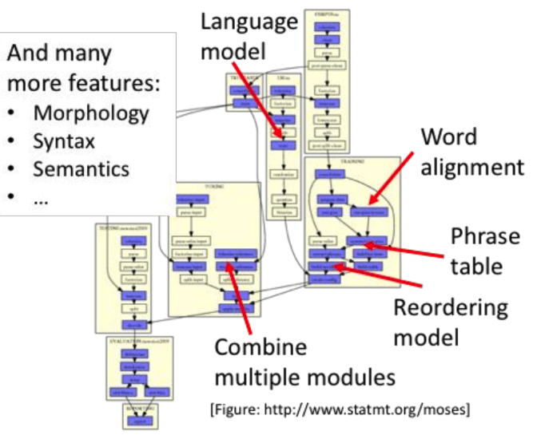
Premise
In the “old days” (aka pre-2013), NLP models were comprised of many hand-engineered features.
Debugging was straight-forward.
Slide based on, inspired by, or directly from Yonatan Belinkov and Jacob Andreas

Slide 7
The black box
Do neural nets learn any kind of interpretable structure?
Can we explain how well they generalize?
When will they succeed and fail?
Why do they make particular decisions?
Output
Deep Neural Network
Input
Slide based on, inspired by, or directly from Yonatan Belinkov and Jacob Andreas

Slide 8
The black box
Why should we care?
Most of deep learning research:
Trail and error, shots in the dark
Better understanding → better systems
Accountability, trust, and bias in machine learning
“Right to explanation”, EU regulation
Life threatening situations: healthcare, autonomous cars
Better understanding → more accountable systems
NNs aid scientific study of language (Linzen 2019)
Models of human language acquisition and processing
Better understanding → better understanding of humans
Slide based on, inspired by, or directly from Yonatan Belinkov and Jacob Andreas

Slide 9
Situation
You’ve developed a deep learning NLP model
Code looks correct to you
It has low accuracy or makes odd errors
What do you do?
Output
Deep Neural Network
Input
Slide based on, inspired by, or directly from Graham Neubig

Slide 10
Debugging
Debugging allows you to identify problems in your assumptions or implementation
Models are often complicated and opaque
Everything is a hyperparameter (e.g., network size, model variations, batch size, optimization, learning rate)
Non-convex, stochastic optimization has no guarantee of converging loss
Slide based on, inspired by, or directly from Graham Neubig

Slide 11
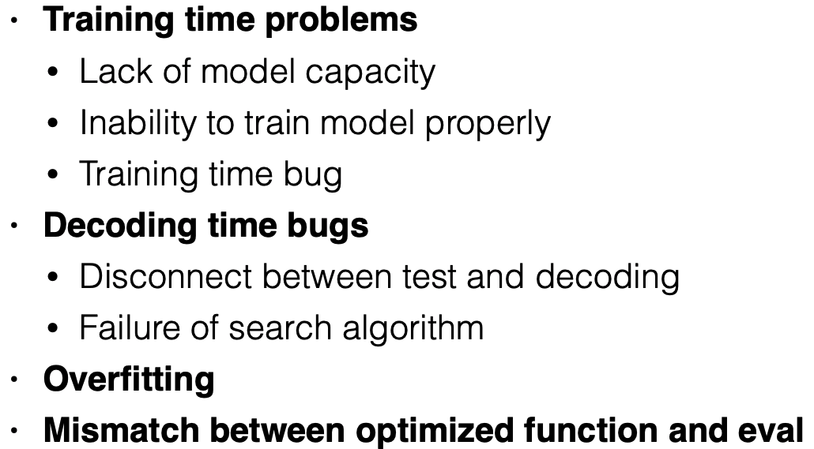
Possible Causes
Debug incrementally!
Slide based on, inspired by, or directly from Graham Neubig

Slide 12
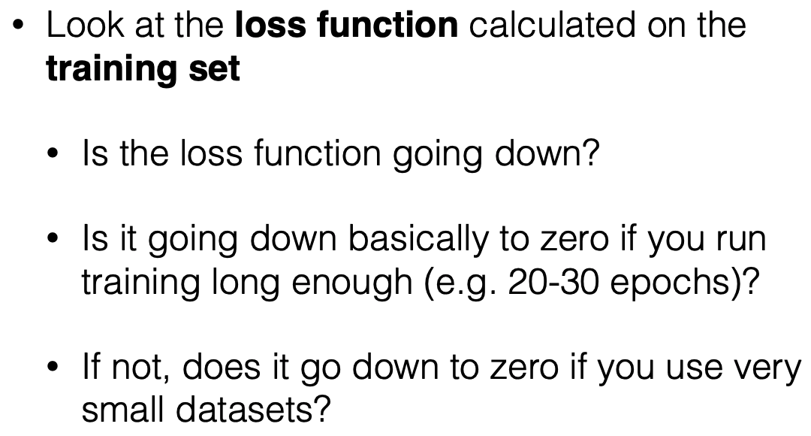
Training
Deliberately try to overfit
Slide based on, inspired by, or directly from Graham Neubig

Slide 13
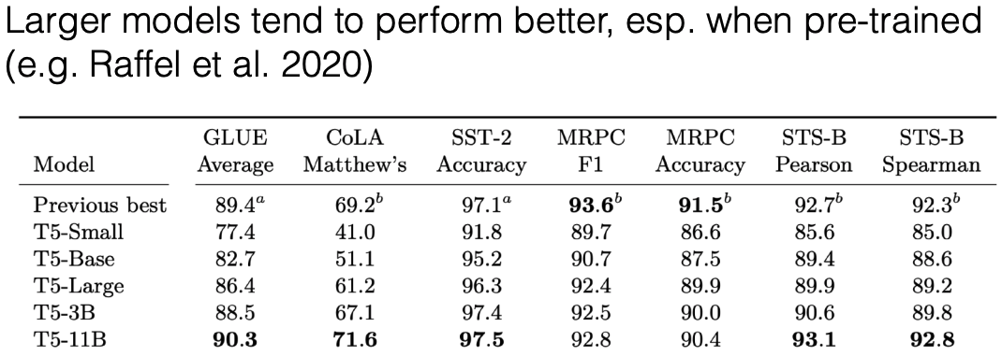
Model expressivity
Slide based on, inspired by, or directly from Graham Neubig

Slide 14
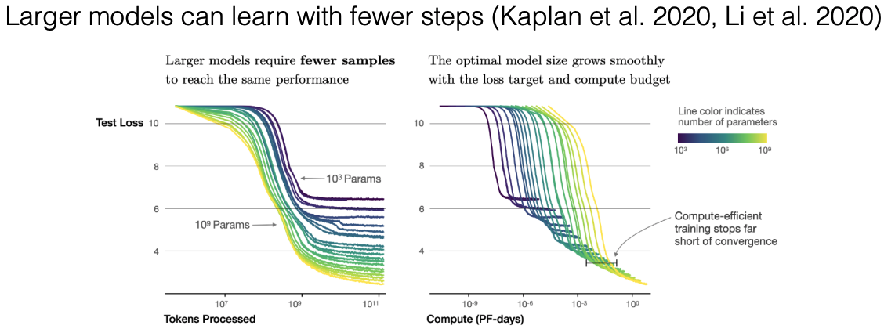
Model expressivity
Slide based on, inspired by, or directly from Graham Neubig

Slide 15
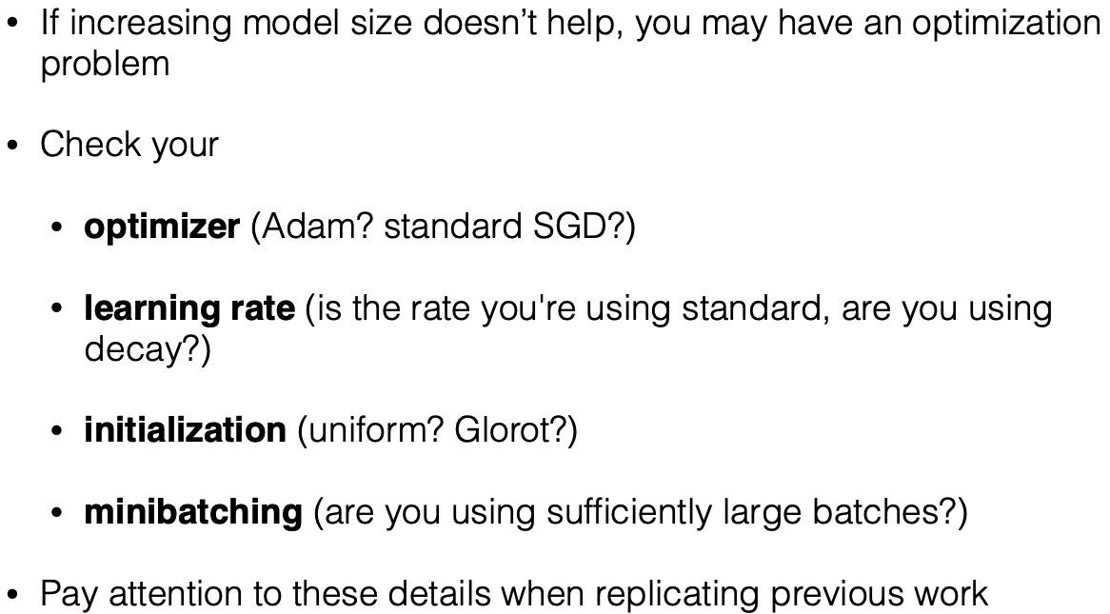
Model expressivity
Slide based on, inspired by, or directly from Graham Neubig

Slide 16
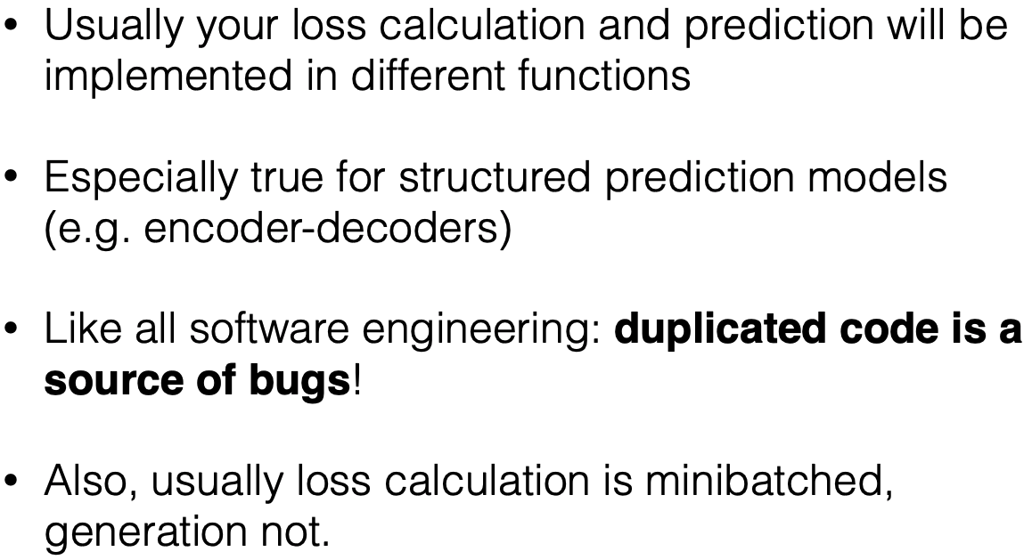
Training/Test Discrepancies
Slide based on, inspired by, or directly from Graham Neubig

Slide 17
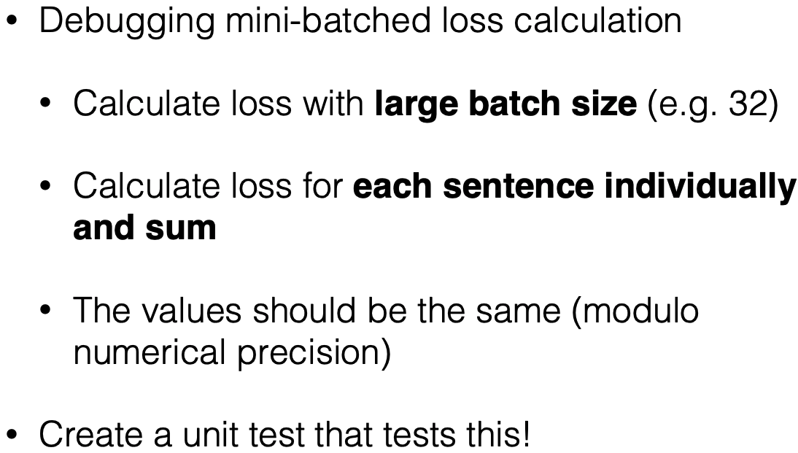
Debugging Mini-batching
Slide based on, inspired by, or directly from Graham Neubig

Slide 18
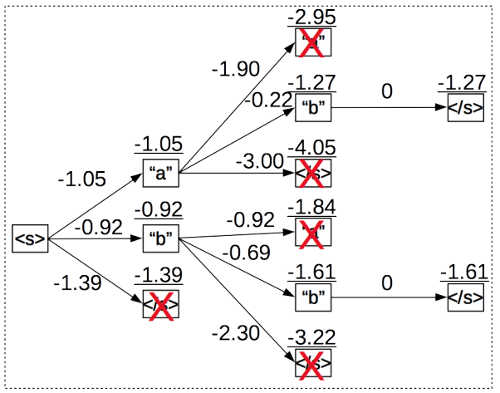
Beam Search
Instead of picking the single-most probable word, maintain several paths
Slide based on, inspired by, or directly from Graham Neubig

Slide 19
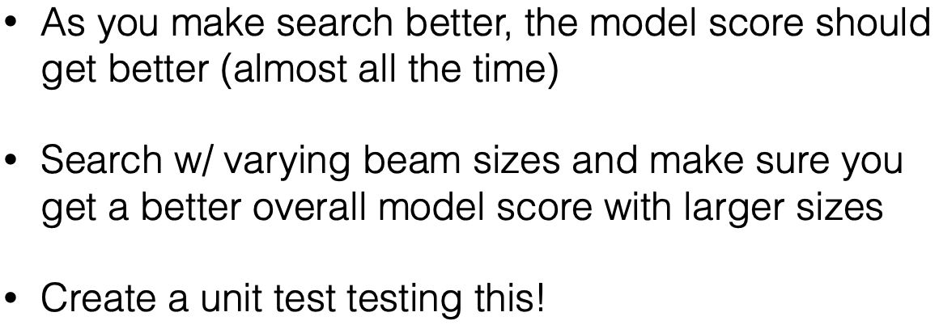
Beam Search
Slide based on, inspired by, or directly from Graham Neubig

Slide 20
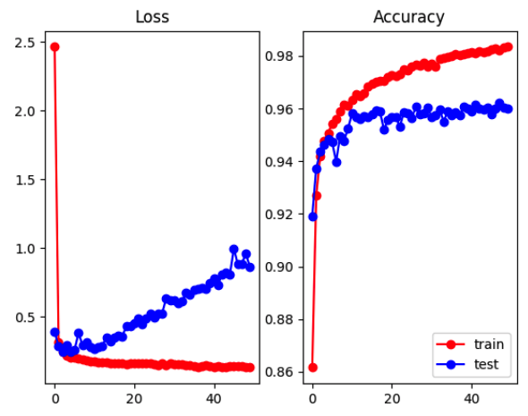
Loss function vs Evaluation metric
Very common to optimize for maximum likelihood for training
Likelihood isn’t necessarily correlated with accuracy
Why?
Slide based on, inspired by, or directly from Graham Neubig
Notes:
Why? Model gets more confident about its mistakes

Slide 21
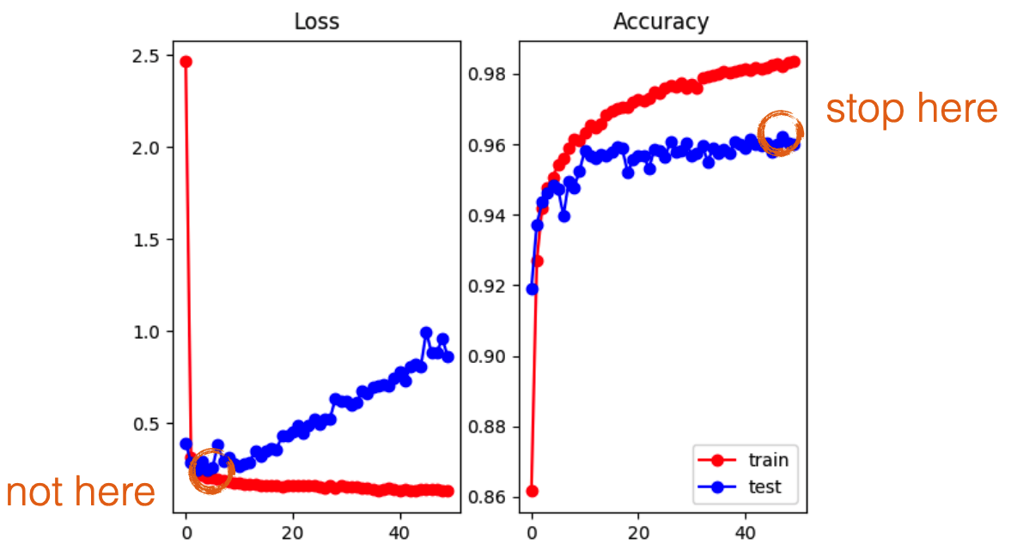
Early Stopping with Evaluation Metric
Slide based on, inspired by, or directly from Graham Neubig

Slide 22
Outline
Model Debugging
Interpretable Evaluation
Interpreting Predictions (Probing)
Workshop time

Slide 23
Outline
Model Debugging
Interpretable Evaluation
Interpreting Predictions (Probing)
Workshop time

Slide 24
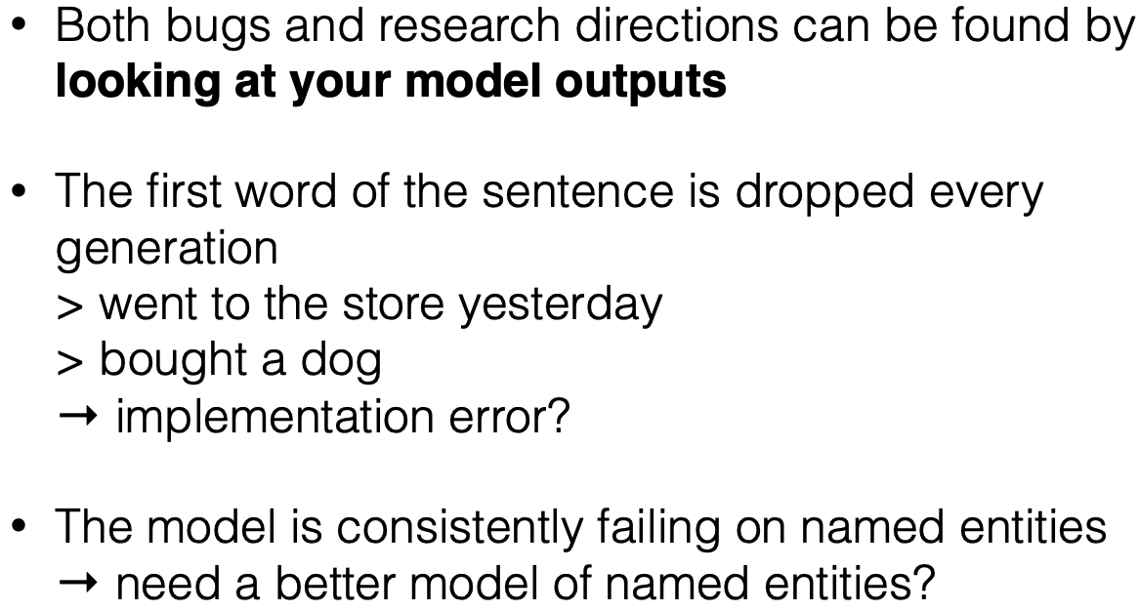
Look at your data
Slide based on, inspired by, or directly from Graham Neubig

Slide 25
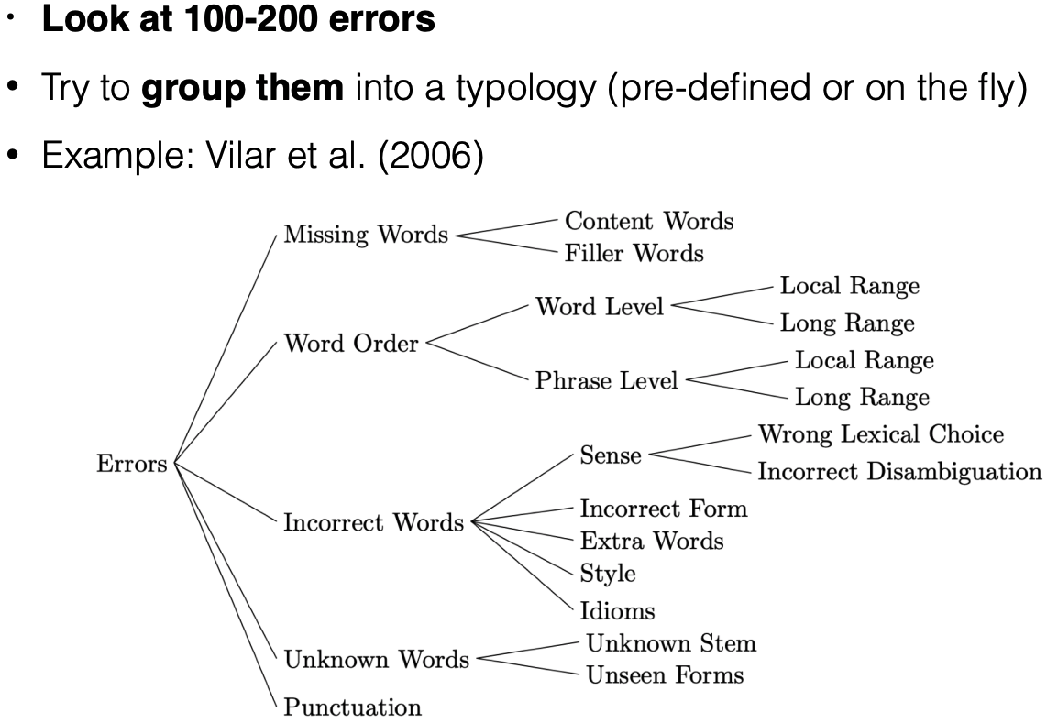
Inspect and categorize your errors
Slide based on, inspired by, or directly from Graham Neubig

Slide 26
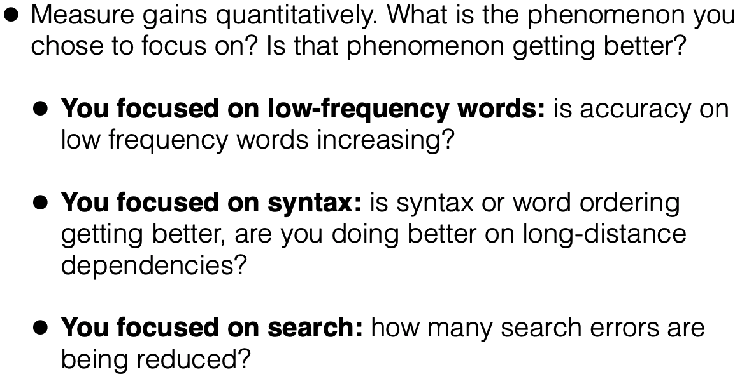
Quantitative Analysis
Slide based on, inspired by, or directly from Graham Neubig

Slide 27
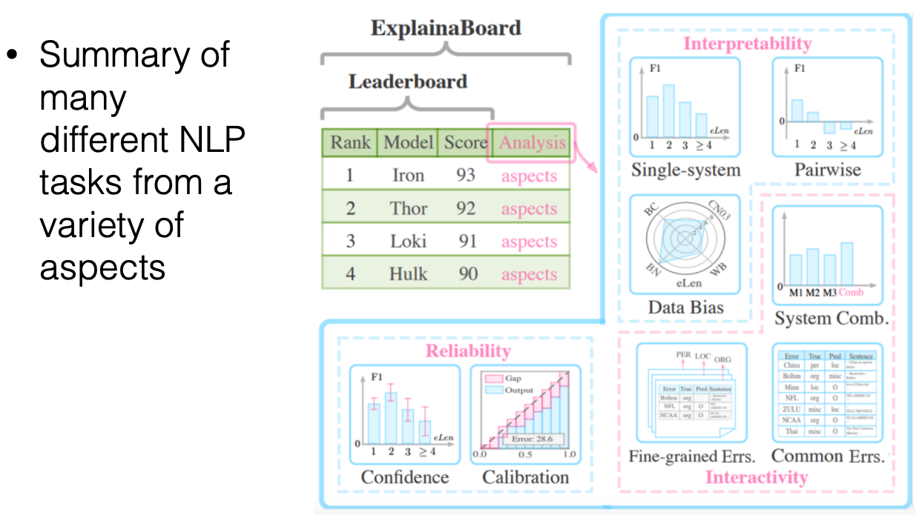
Example: ExplainaBoard
http://explainaboard.nlpedia.ai/
Slide based on, inspired by, or directly from Graham Neubig

Slide 28
Outline
Model Debugging
Interpretable Evaluation
Interpreting Predictions (Probing)
Workshop time

Slide 29
Outline
Model Debugging
Interpretable Evaluation
Interpreting Predictions (Probing)
Workshop time

Slide 30
The big picture
Understanding the general properties of the model
Analysis and debugging
Easier, generally used to guide engineering work or answer specific scientific questions
Understanding the properties of a model applied to a specific example
Explainability and interpretability
Harder, generally used to validate a model’s decision in high-stakes situations (e.g., medical, legal, financial, etc)
The EU has the ‘right to explanation’ for computational models used to make decisions about people
Slide based on, inspired by, or directly from Sam Bowman

Slide 31
Motivation
You want to know which words were used in making a classification decision to verify its accuracy.
You want to know whether your model has legitimately learned a difficult pattern, or if it’s focused on spurious correlations.
You want to understand what information a pre-trained model has captured internally
Slide based on, inspired by, or directly from Sam Bowman

Slide 32
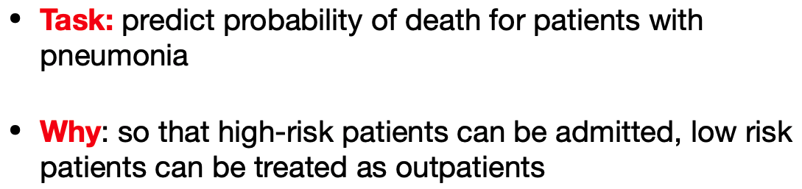
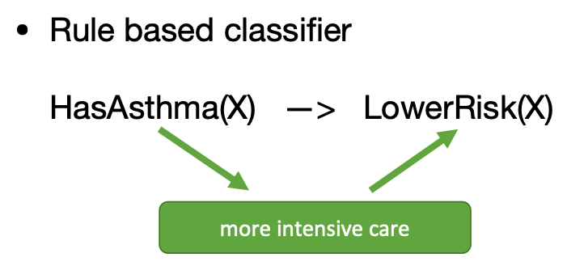

Example
Slide based on, inspired by, or directly from Graham Neubig

Slide 33
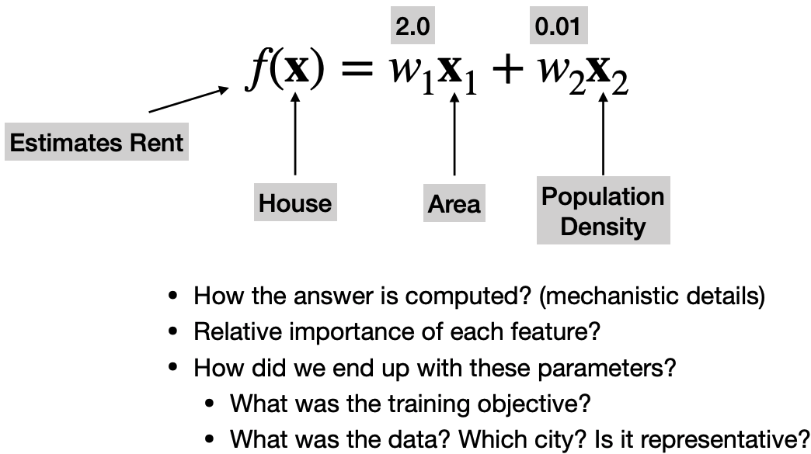
LIME
Linear models are very interpretable
Slide based on, inspired by, or directly from Graham Neubig

Slide 34
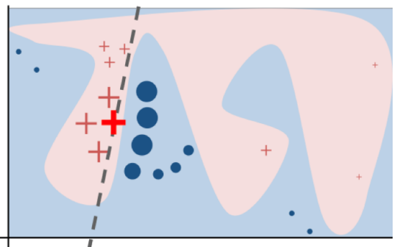
LIME
Select a specific neighborhood of data and a subset of the features
Slide based on, inspired by, or directly from Graham Neubig

Slide 35
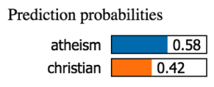
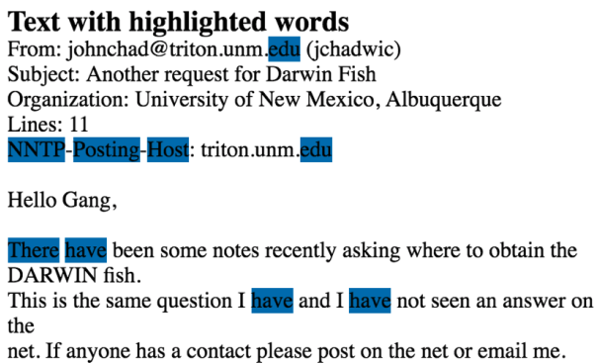
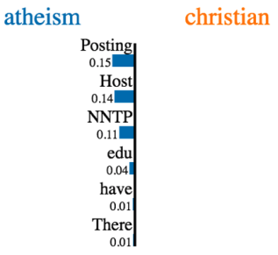

LIME
Select a specific neighborhood of data and a subset of the features
Slide based on, inspired by, or directly from Graham Neubig

Slide 36
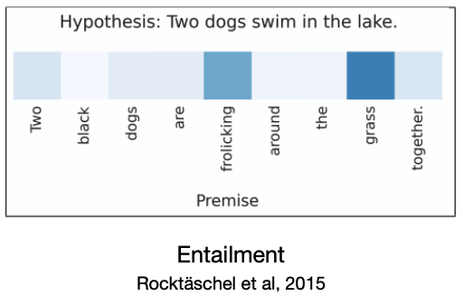
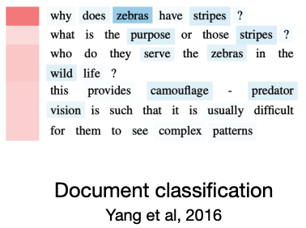
Attention
Inspecting Attention
Slide based on, inspired by, or directly from Graham Neubig

Slide 37
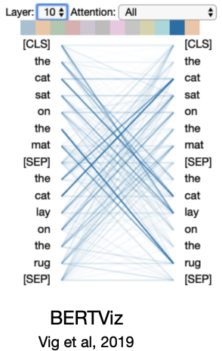
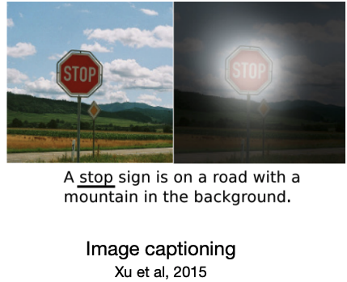
Attention
Inspecting Attention
Slide based on, inspired by, or directly from Graham Neubig

Slide 38
Attention
Does Attention answer all of our questions? Provides all the insights we want?

Slide 39
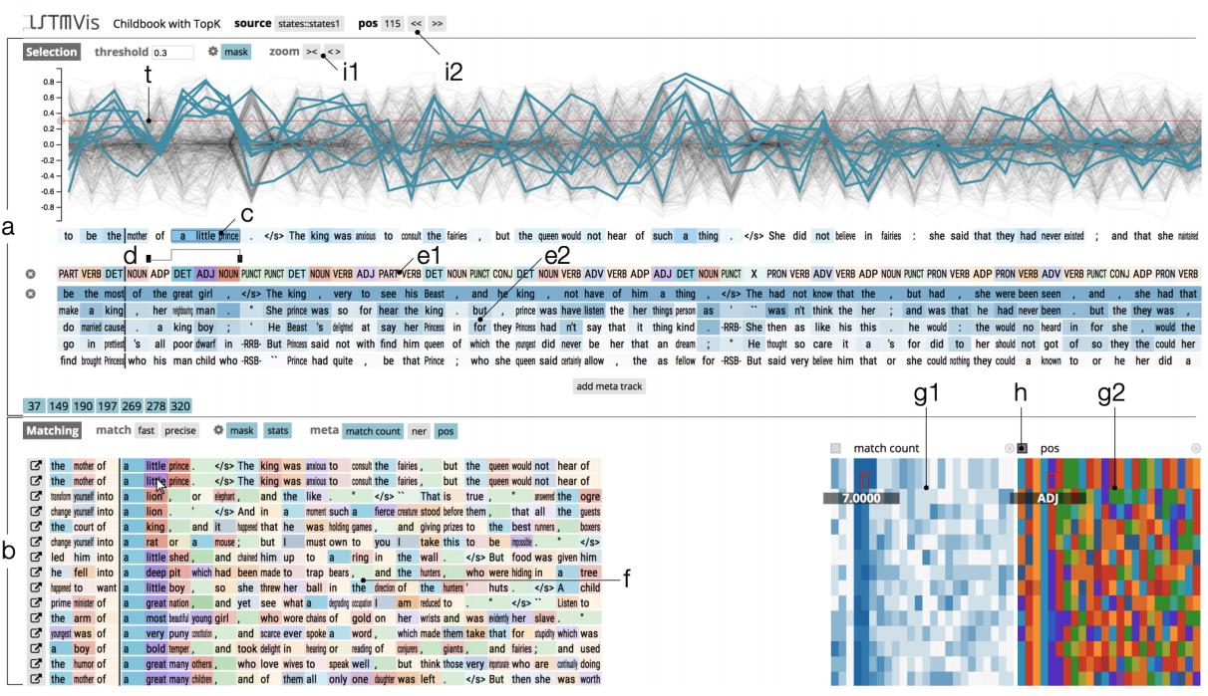
Attention
Slide based on, inspired by, or directly Mohit Iyyer

Slide 40
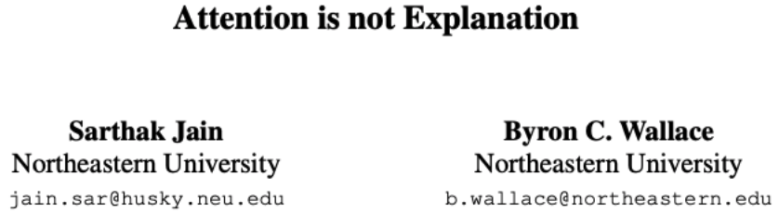
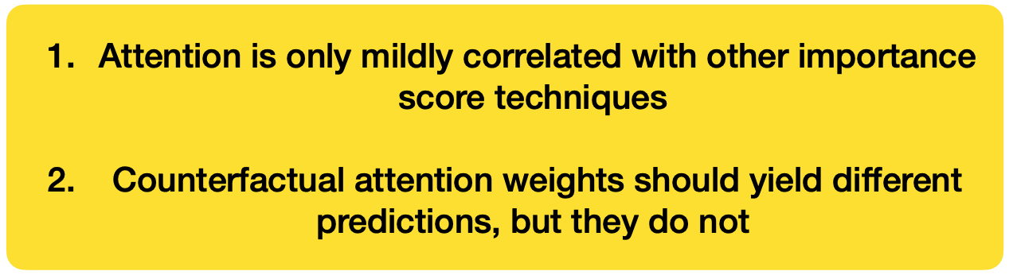
Slide based on, inspired by, or directly from Graham Neubig

Slide 41
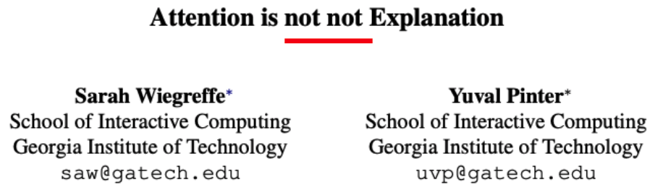
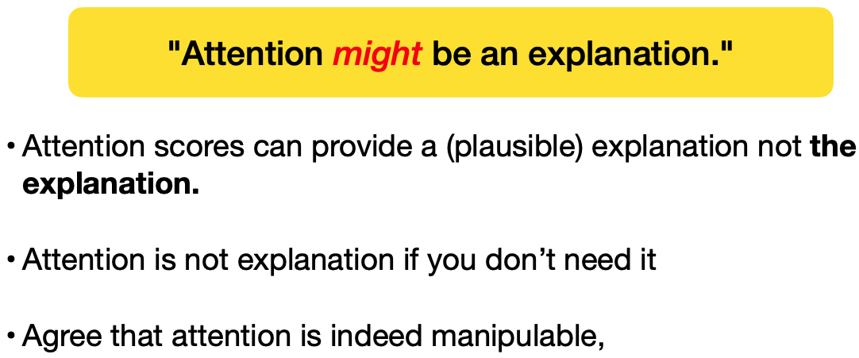
Slide based on, inspired by, or directly from Graham Neubig

Slide 42
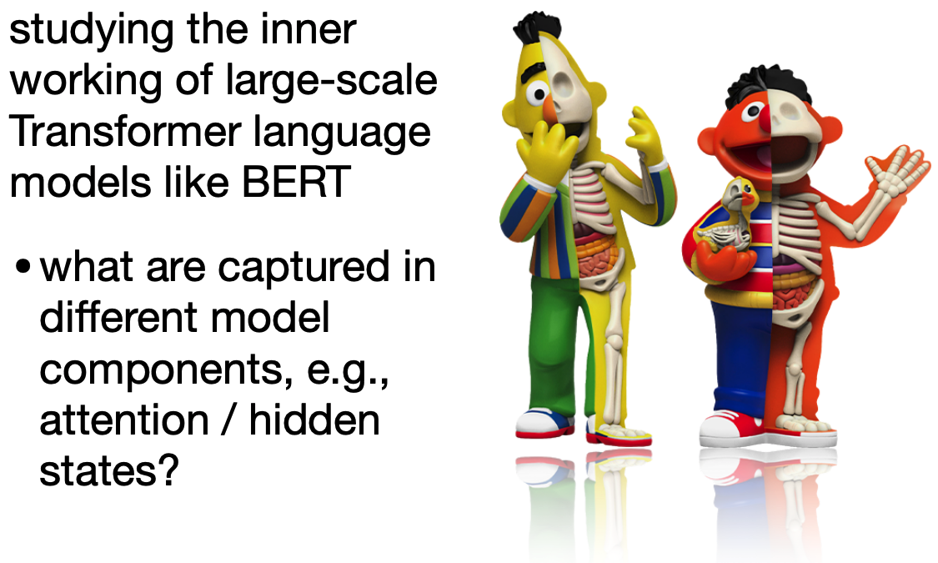
BERTology
Slide based on, inspired by, or directly from Mohit Iyyer

Slide 43
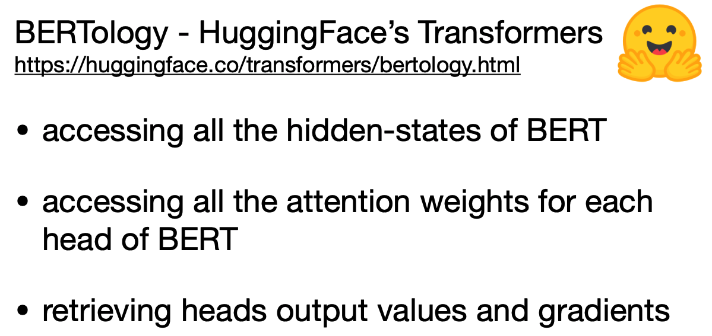
Tools
Slide based on, inspired by, or directly from Mohit Iyyer

Slide 44
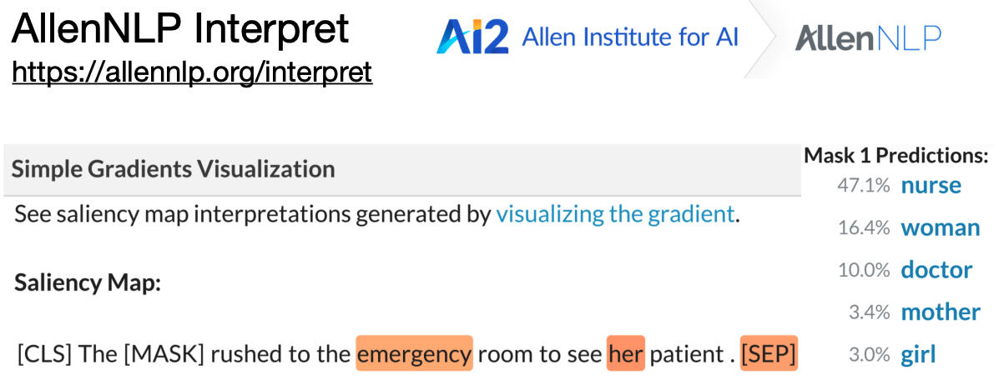
Tools
Slide based on, inspired by, or directly from Mohit Iyyer

Slide 45
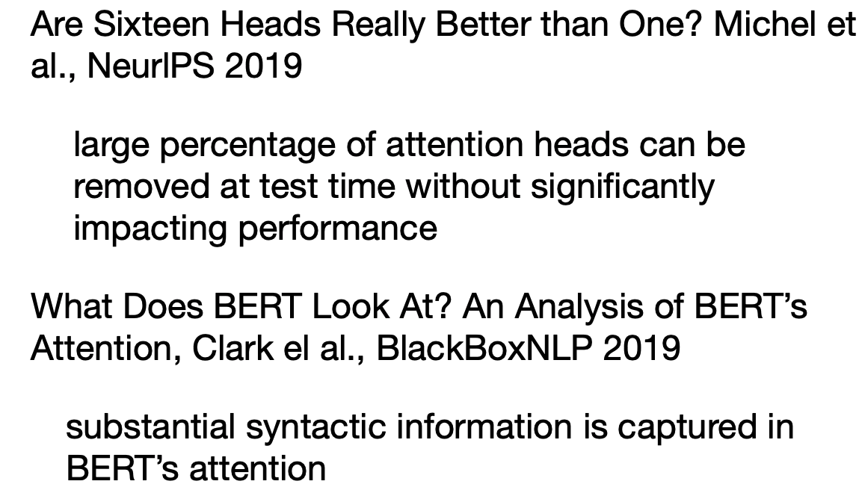
Findings
Slide based on, inspired by, or directly from Mohit Iyyer

Slide 46
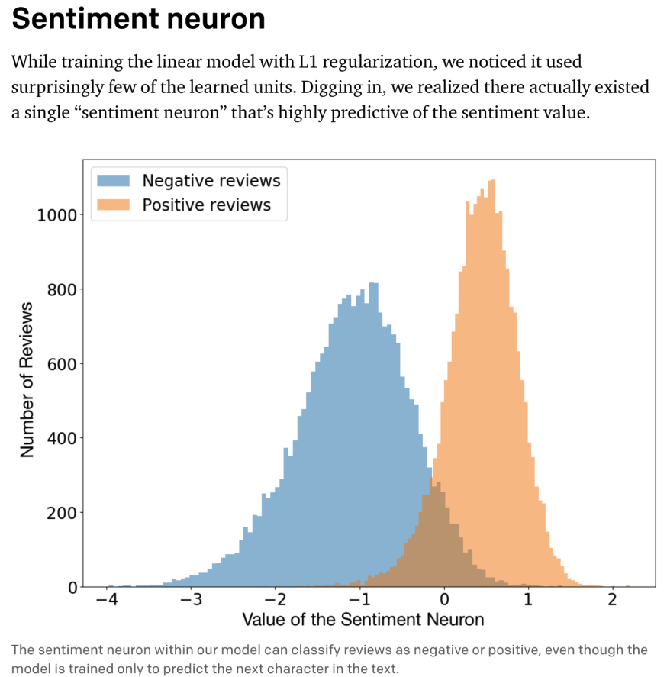
What if we fall back to just single neurons?
https://openai.com/blog/unsupervised-sentiment-neuron/
Slide based on, inspired by, or directly from Mohit Iyyer

Slide 47
Probing
Given an encoder model (e.g., BERT) pretrained on a certain task, we use the representations it produces to train a classifier (without further fine-tuning the model) to predict a linguistic property of the input text.
Slide based on, inspired by, or directly from Mohit Iyyer

Slide 48
Probing
If we can train a simple classifier to predict a property of the input text based on its representation, it means the property is encoded somewhere in the representation.
If we cannot, it may or may not be encoded.
Slide based on, inspired by, or directly from Mohit Iyyer

Slide 49
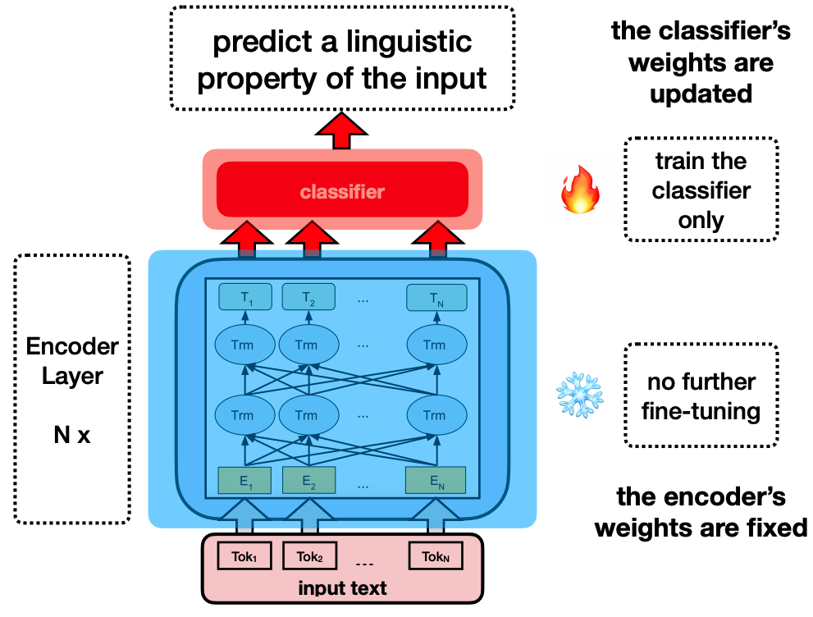
Probing
Slide based on, inspired by, or directly from Mohit Iyyer

Slide 50
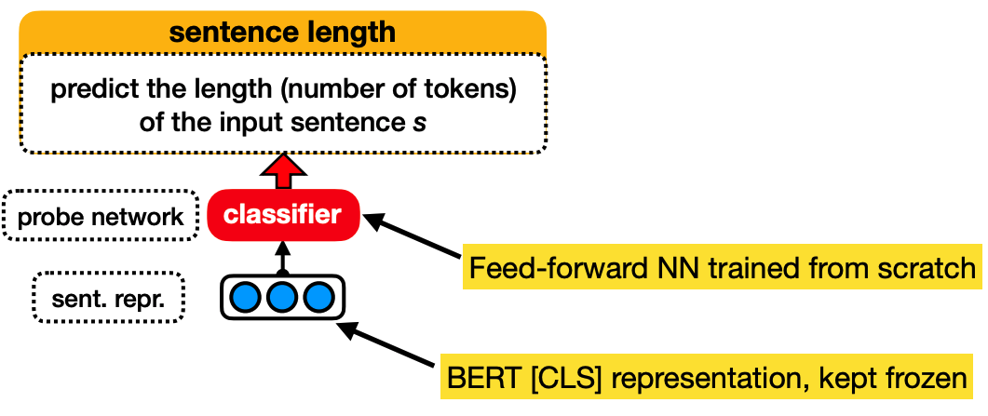
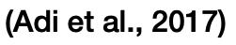
Probing
Slide based on, inspired by, or directly from Mohit Iyyer

Slide 51
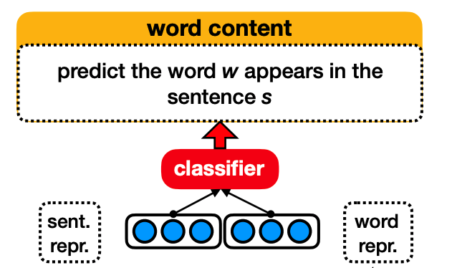
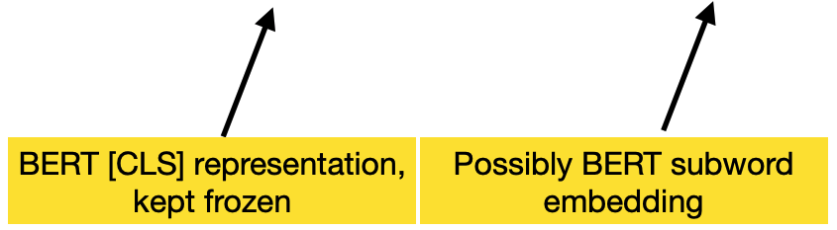
Probing
Slide based on, inspired by, or directly from Mohit Iyyer

Slide 52
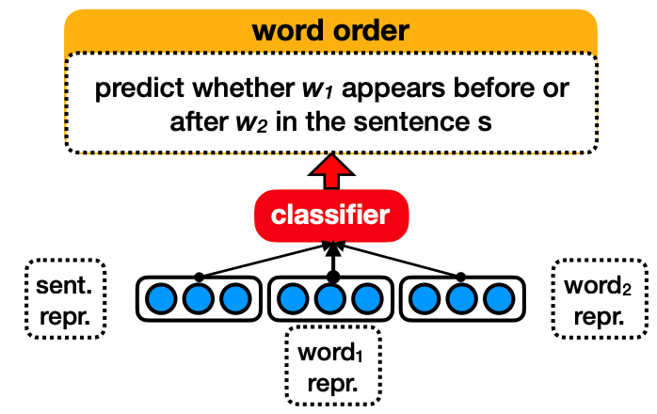
Probing
Slide based on, inspired by, or directly from Mohit Iyyer

Slide 53
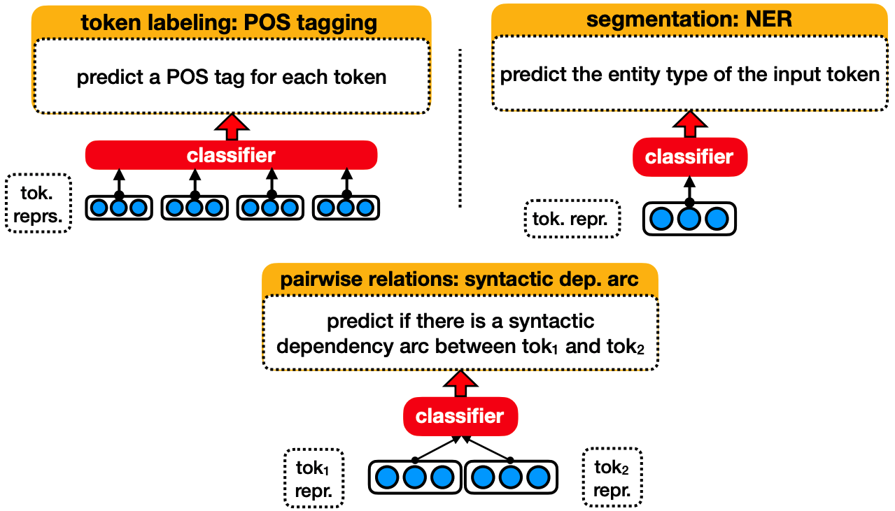
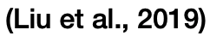
Probing

Slide 54
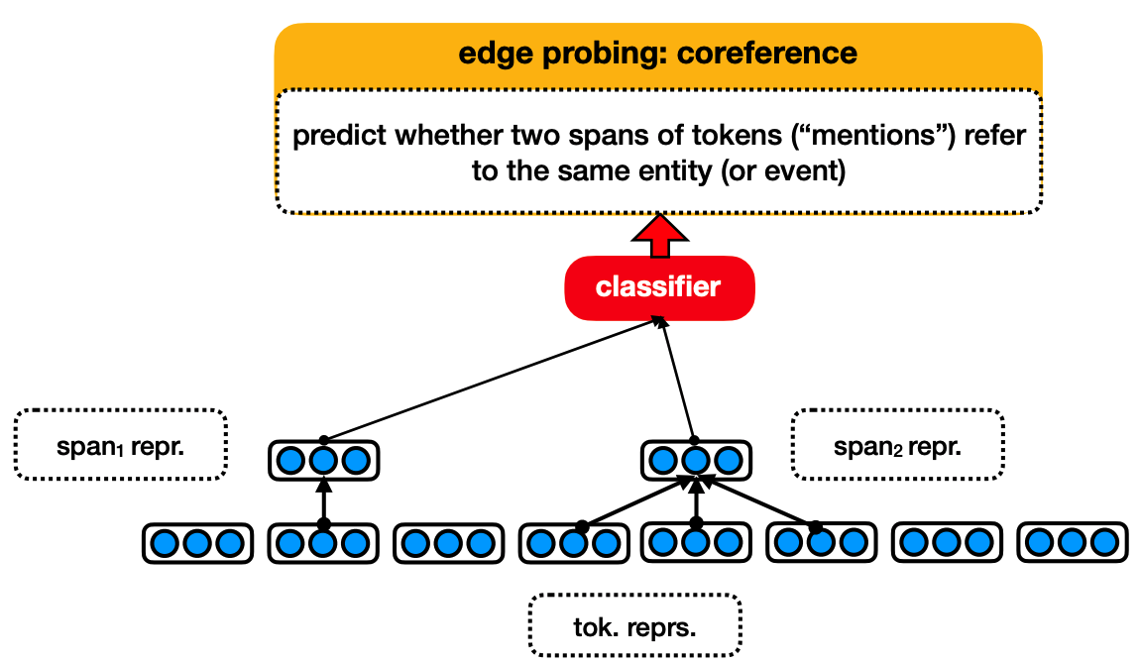
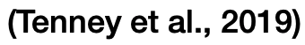
Probing

Slide 55
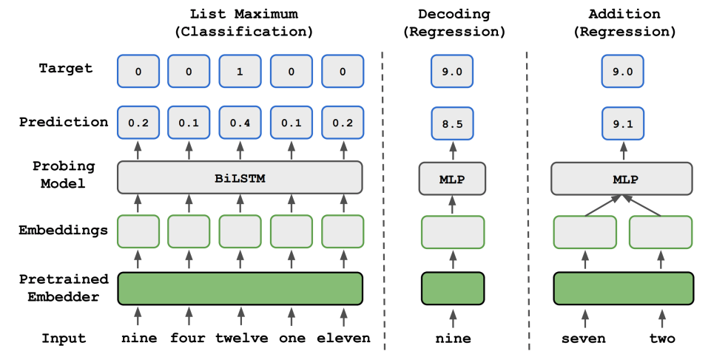
Probing

Slide 56
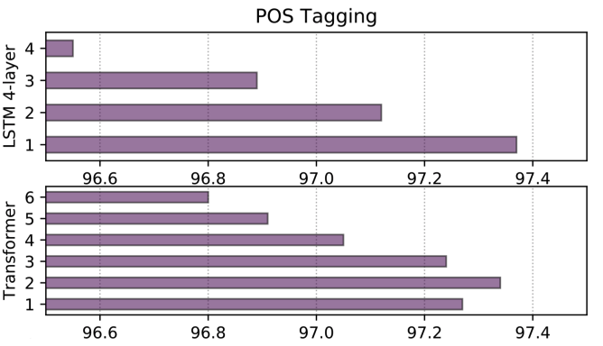
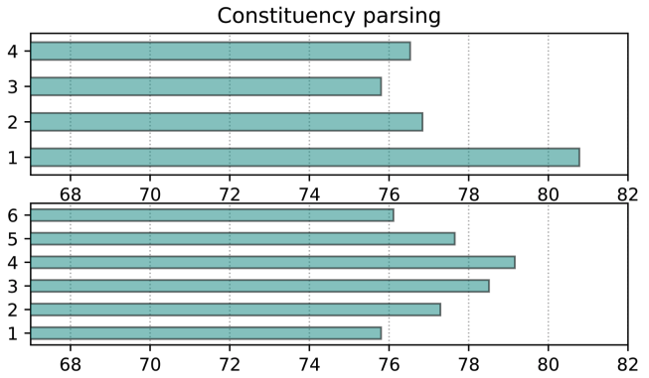

Probing
Lower layers capture more on syntax, upper layers capture more semantics

Slide 57

Probing
Lower layers capture more on syntax, upper layers capture more semantics

Slide 58


Probing
Lower layers capture more on syntax, upper layers capture more semantics

Slide 59

Probing
Does BERT encode syntactic structure?

Slide 60

Probing
Does BERT encode syntactic structure?

Slide 61

Probing
Does BERT encode syntactic structure?

Slide 62

Probing
Does BERT encode syntactic structure?

Slide 63


Probing
Does BERT know numbers?

Slide 64

Probing
Does BERT know numbers?

Slide 65


Probing
LAMA (LAnguage Model Analysis) probe
Does BERT know world knowledge?

Slide 66

Probing
LAMA (LAnguage Model Analysis) probe
Does BERT know world knowledge?

Slide 67

Probing
LAMA (LAnguage Model Analysis) probe
Does BERT know world knowledge?

Slide 68


Probing

Slide 69
Probing
Probing seems great.
Any negatives?

Slide 70
Probing
Does not necessarily correlate with downstream performance
Probe may simply learn the task

Slide 71


Probing
Slide based on, inspired by, or directly from Mohit Iyyer

Slide 72

Probing with Control Tasks
Slide based on, inspired by, or directly from Mohit Iyyer

Slide 73

Probing with Control Tasks
Slide based on, inspired by, or directly from Mohit Iyyer

Slide 74


Probing with Control Tasks
Slide based on, inspired by, or directly from Mohit Iyyer

Slide 75

Probing with Control Tasks
Be careful about probe accuracies!
Slide based on, inspired by, or directly from Mohit Iyyer

Slide 76
Conclusions
Just like with all of Machine Learning and Data Science, scrutinize your data and results
Inspect your model, generally, to ensure it’s correctly implemented and sound
Inspect your predictions to ensure your evaluations are sound
Inspect your model’s internals to understand why it makes its predictions
Dissect your method above to ensure it’s fair and accurate

